Slide 1
Management & Organisational Behaviour 4
Module Code: ENGE08016

Slide 2
Strategic Frameworks

Slide 3

Learning Objective
What is a Strategic Framework
Strategic Framework vs Model
S.W.O.T
Issue Based Strategic Planning
Balanced Scorecard
Objective and Key Results (OKRs)
Gap Planning
PEST Analysis
Image Source: Businessday NG

Slide 4

What is a Strategic Framework?
A strategic framework is a structured and organized approach that provides a fundamental structure to guide an organization in setting its long-term goals, making informed decisions, allocating resources, and ultimately achieving its vision and mission.
It serves as a blueprint that outlines the direction, priorities, and action plans necessary to reach the desired future state of the organization.
Image Source: Experiencing Information

Slide 5
What is a Strategic Framework?
Key components of a strategic framework typically include:
Vision and Mission:
Vision: A clear and aspirational statement describing the desired future state or long-term goal the organization aims to achieve.
Mission: A concise declaration of the organization's purpose, core values, and primary activities that define its existence and reason for being.
Goals and Objectives:
Goals: Broad, overarching statements that align with the organization's vision and provide strategic direction.
Objectives: Specific, measurable, achievable, relevant, and time-bound (SMART) targets derived from goals, serving as actionable steps to move towards the vision.
Strategies:
Defined approaches and plans that outline how the organization intends to achieve its objectives and, ultimately, its vision.
Strategies encompass decisions regarding market positioning, resource allocation, competitive advantage, and differentiation.

Slide 6
What is a Strategic Framework?
Key components of a strategic framework typically include:
Key Performance Indicators (KPIs):
Quantifiable metrics used to measure the organization's progress in achieving its objectives and goals.
KPIs help monitor performance, assess effectiveness, and make informed adjustments to strategies and actions.
Action Plans and Initiatives:
Specific projects, tasks, or activities that operationalize the strategies and enable the achievement of objectives.
Action plans outline responsibilities, timelines, budgets, and required resources for successful implementation.
Risk Assessment and Mitigation:
Evaluation of potential risks and challenges that may hinder the attainment of objectives or realization of the vision.
Strategies and plans to mitigate and manage risks to ensure resilience and adaptability in the strategic approach.

Slide 7
What is a Strategic Framework?
Key components of a strategic framework typically include:
Resource Allocation:
Allocation of human, financial, technological, and other resources required to execute strategies and initiatives effectively.
This involves determining the optimal use of resources to align with organizational priorities.
Monitoring and Evaluation:
Systems and processes to regularly monitor progress, assess performance against KPIs, and evaluate the effectiveness of strategies and initiatives.
Feedback loops and mechanisms for making necessary adjustments and improvements to stay aligned with the strategic framework.

Slide 8
Strategic Framework vs Model
Strategic Planning Framework:
A strategic planning framework is a broad structure or outline that guides the entire strategic planning process within an organization.
It provides a high-level view of how the strategic planning process will be organized, the key components that need to be considered, and the relationships among these components.
The framework defines the overall structure and approach to strategic planning, allowing for flexibility and adaptation to suit the specific needs and context of the organization.
Strategic Planning Models:
Strategic planning models are specific methodologies or systematic approaches used within the overarching framework to carry out the strategic planning process.
These models are more detailed and provide step-by-step procedures, tools, and techniques for conducting strategic planning.
Each model may have its own unique steps, stages, or phases that organizations follow to define their mission, vision, goals, objectives, strategies, and action plans.
Models offer a structured way to analyze the organization's internal and external environment, identify strengths, weaknesses, opportunities, and threats, and formulate strategies accordingly.

Slide 9
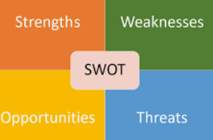
S.W.O.T
A SWOT analysis is a strategic planning tool used to evaluate the internal Strengths and Weaknesses, as well as the external Opportunities and Threats facing an organization.
Strengths (S):
Strengths are internal, positive attributes and characteristics within the organization.
These factors give the organization a competitive advantage and contribute to its success.
Strengths could include a strong brand, skilled workforce, efficient processes, proprietary technology, or a loyal customer base.
Weaknesses (W):
Weaknesses are internal, negative aspects or limitations within the organization that hinder its performance or growth.
Identifying weaknesses is crucial for understanding areas that need improvement and development.
Weaknesses might involve inadequate resources, outdated technology, poor management, or a lack of certain skills or expertise.
Image Source: Tallyfy

Slide 10
S.W.O.T
Opportunities (O):
Opportunities are external, favourable factors or circumstances that the organization can capitalize on to achieve its goals and objectives.
Recognizing opportunities is essential for aligning organizational strategies with potential growth areas.
Opportunities may arise from market trends, technological advancements, changes in regulations, emerging markets, or partnerships.
Threats (T):
Threats are external, unfavourable factors or challenges that could negatively impact the organization's performance and success.
Identifying threats helps the organization develop strategies to mitigate or overcome these challenges.
Threats could include intense competition, economic downturns, changing consumer behaviour, disruptive technologies, or unfavourable market conditions.
Image Source: Tallyfy

Slide 11
Issue Based Strategic Planning
Issue-based strategic planning is a strategic management approach that focuses on addressing specific critical issues or challenges facing an organization. Instead of formulating strategies based on a broad analysis of the organization's internal and external environment, issue-based strategic planning focuses on specific problems or opportunities that need immediate attention and resolution.
Identifying Key Issues:
Begin by identifying the most pressing issues, challenges, or opportunities that require strategic intervention.
These issues are typically critical to the organization's success, growth, sustainability, or competitive positioning.
Analyzing Key Issues:
Conduct a thorough analysis of each identified issue to understand its root causes, implications, and potential impact on the organization.
Gather relevant data, involve stakeholders, and employ appropriate analytical tools to gain a comprehensive understanding of the issues.
Setting Priorities:
Prioritize the identified issues based on their urgency, impact on organizational objectives, and alignment with the organization's mission and vision.
Assign a level of importance to each issue to guide resource allocation and focus on the most critical concerns.
Formulating Strategies:
Develop strategies tailored to address each identified issue effectively and efficiently.
Ensure that each strategy is targeted, actionable, and aligned with the overall goals and objectives of the organization.
Allocating Resources:
Allocate necessary resources such as finances, personnel, time, and technology to implement the chosen strategies for issue resolution.
Optimize resource allocation to maximize the potential impact of the strategies on issue resolution.
Implementing Action Plans:
Create detailed action plans for executing the chosen strategies.
Specify clear objectives, timelines, responsibilities, and performance indicators for monitoring progress and ensuring successful implementation.
Monitoring and Evaluation:
Continuously monitor the progress of strategy implementation and the resolution of the identified issues.
Evaluate the effectiveness of the strategies based on predefined metrics and make adjustments as needed to achieve desired outcomes.
Learning and Adaptation:
Encourage a culture of continuous learning and adaptation within the organization.
Gather insights and lessons from the issue-based strategic planning process to enhance future planning and decision-making.

Slide 12
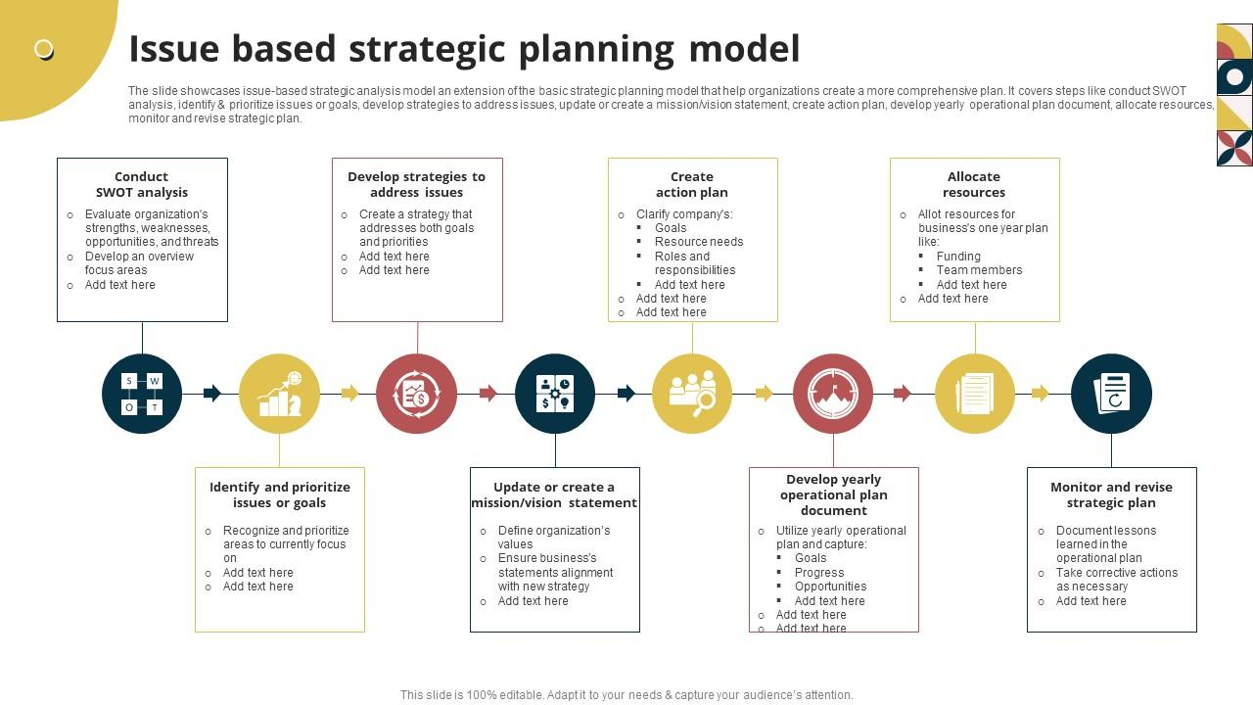
Sample Issue Based Strategic Planning
Image Source: Slideteam

Slide 13
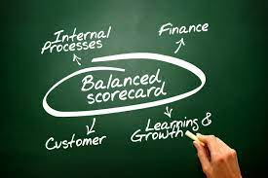
Balanced Scorecard
The Balanced Scorecard (BSC) is a strategic management framework and performance measurement system that helps organizations translate their strategy into specific objectives and key performance indicators (KPIs) across multiple perspectives. It was introduced by Robert S. Kaplan and David P. Norton in the early 1990s as a tool to address the shortcomings of traditional performance measurement systems that often focused solely on financial metrics.
Image Source: Leading Edge Group

Slide 14
Balanced Scorecard
Financial Perspective:
Focuses on financial outcomes and objectives that directly impact the organization's financial success and sustainability.
Examples include revenue growth, cost management, profitability, return on investment (ROI), and cash flow.
Customer Perspective:
Emphasizes meeting customer needs and delivering value to customers, thus driving customer satisfaction and loyalty.
Involves objectives related to customer service, market share, customer retention, and customer perception of product/service quality.
Internal Business Processes Perspective:
Concentrates on the critical processes and operations that are essential for delivering value to customers and stakeholders.
Objectives in this perspective may include process efficiency, quality improvement, innovation, and time-to-market.
Learning and Growth (or Organizational Capability) Perspective:
Focuses on the organization's ability to learn, innovate, and grow to sustain long-term success.
Objectives in this perspective may include employee training and development, knowledge management, organizational culture, and technology advancement.

Slide 15
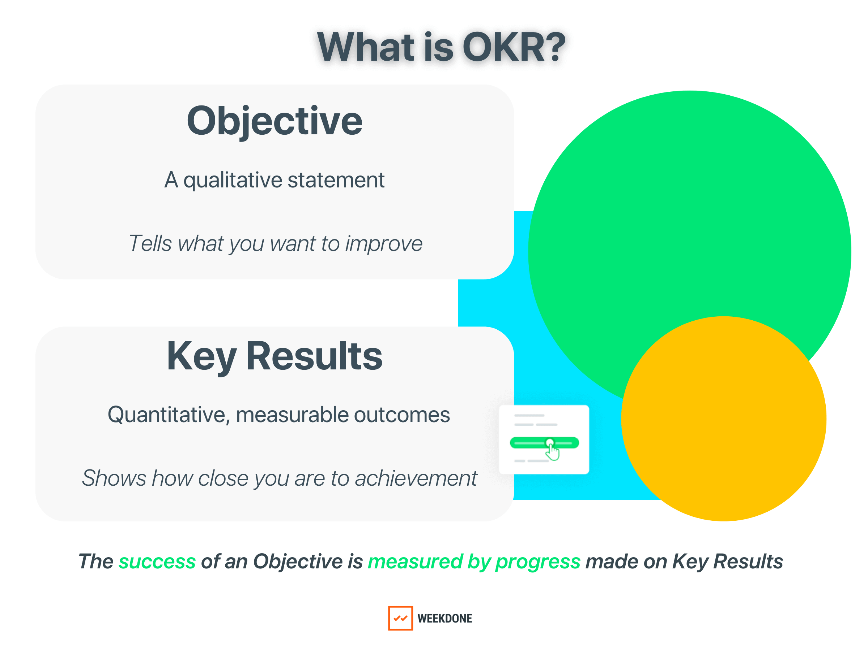
Objective and Key Results (OKRs)
Objective and Key Results (OKRs) is a goal-setting and performance management framework that helps organizations define and track objectives and their corresponding measurable outcomes.
It was popularized by Intel and later refined and adopted by companies like Google and many others. OKRs are designed to align teams and individuals with organizational objectives and drive progress toward achieving strategic goals.
Image Source: Whatmatters.com

Slide 16
Objective and Key Results (OKRs)
Objectives (O):
Objectives are ambitious, qualitative, and inspirational statements that define what an organization, team, or individual aims to achieve within a specific timeframe.
Objectives should be aligned with the organization's mission, vision, and strategic priorities, providing direction and clarity on what needs to be accomplished.
They are usually set on a quarterly or annual basis and are meant to be challenging, motivating, and feasible.
Key Results (KR):
Key Results are specific, measurable, quantifiable, and time-bound metrics that define the success criteria for achieving an objective.
Each objective typically has two to five key results, outlining the outcomes or milestones that must be reached to consider the objective successfully achieved.
Key Results serve as a way to track progress and measure the degree of success in meeting the objective.

Slide 17
Objective and Key Results (OKRs)
Alignment:
OKRs are designed to cascade down the organizational hierarchy, ensuring alignment of objectives from the organizational level to teams and individuals.
The alignment helps in fostering a cohesive effort across the organization, ensuring that every individual's objectives contribute to achieving higher-level organizational goals.
Transparency and Visibility:
OKRs are typically shared transparently across the organization, promoting a culture of openness and sharing of goals and progress.
This visibility allows teams and individuals to understand the broader organizational objectives and how their efforts contribute to the overall success.
Regular Check-ins and Progress Tracking:
Regular check-ins, often weekly or bi-weekly, are held to review progress on key results and discuss any challenges or adjustments needed to stay on track.
Progress is tracked against key results, and adjustments are made to strategies or actions as necessary to ensure objectives are met by the end of the defined timeframe.

Slide 18
Objective and Key Results (OKRs)
Stretch Goals and Continuous Improvement:
OKRs often include "stretch" goals to encourage teams to aim for higher levels of achievement, pushing beyond what may initially seem feasible.
The objective is to foster a culture of continuous improvement, innovation, and striving for excellence.
Adaptability and Flexibility:
OKRs allow for adjustments and changes as circumstances evolve or new priorities emerge during the defined period.
Flexibility enables organizations to stay responsive to market changes, customer needs, and internal developments.

Slide 19
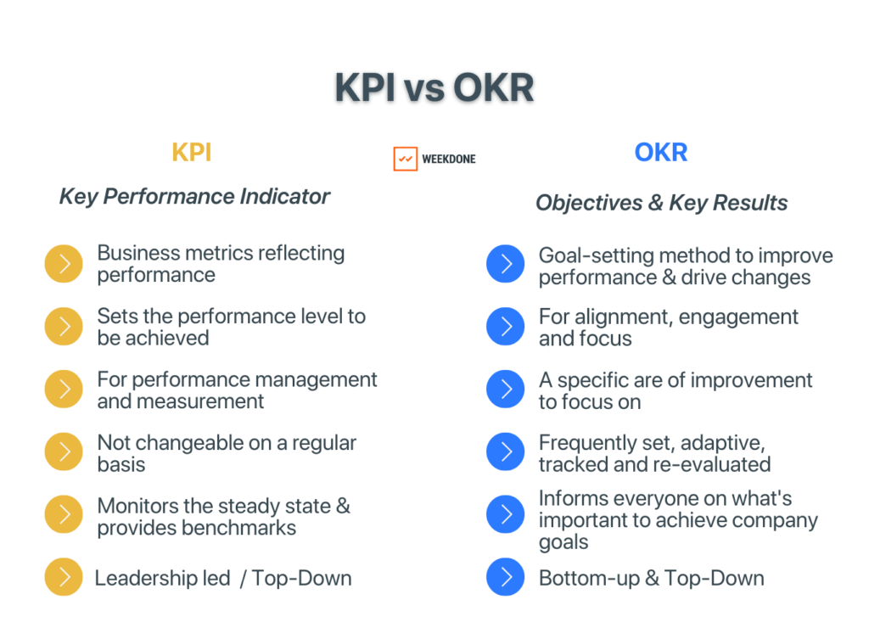
Objective and Key Results (OKRs)
Image Source: weekdone

Slide 20
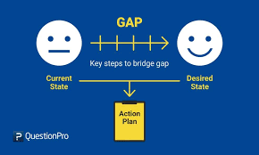
Gap Planning
Gap planning, also known as gap analysis or needs analysis, is a strategic management process used by organizations to assess the difference or "gap" between their current state (where they currently stand) and their desired future state (where they want to be).
This analysis helps identify the steps, changes, or improvements needed to bridge this gap and achieve organizational goals and objectives effectively.
Image Source: Question Pro

Slide 21
Gap Planning
Current State Assessment:
Evaluate the organization's current performance, capabilities, resources, processes, and other relevant factors to understand the present situation comprehensively.
Gather data and insights to identify strengths, weaknesses, opportunities, and threats (SWOT analysis) affecting the organization.
Desired Future State Definition:
Clearly define the organization's vision, goals, objectives, or targets for a specific period (e.g., short-term, mid-term, or long-term).
Establish specific and measurable outcomes that the organization aims to achieve within the defined timeframe.
Gap Identification:
Compare the current state assessment with the desired future state to identify the gaps in performance, capabilities, resources, processes, or any other relevant areas.
The gap represents the difference between where the organization is and where it aims to be.
Gap Analysis:
Analyze the identified gaps to understand their root causes and factors contributing to the differences between the current and desired states.
This analysis helps identify the reasons behind the gaps and provides insights into what needs to be addressed to bridge them.

Slide 22
Gap Planning
Strategies and Action Plans:
Develop strategies and action plans to bridge the identified gaps and move the organization from the current state to the desired future state.
Determine specific initiatives, projects, activities, or changes required to close the gaps and achieve organizational goals.
Resource Allocation:
Allocate the necessary resources, such as financial, human, technological, and time resources, to implement the identified strategies and action plans effectively.
Ensure that resource allocation is aligned with the priority and importance of bridging the identified gaps.
Monitoring and Execution:
Implement the action plans and initiatives according to the defined timelines and milestones.
Regularly monitor progress, track performance, and measure outcomes to ensure that the actions taken are effective in closing the identified gaps.
Feedback and Adjustments:
Gather feedback and data throughout the implementation process to assess the effectiveness of the strategies and initiatives.
Make necessary adjustments, refine strategies, and update action plans based on the feedback received and changes in the organization's context.

Slide 23
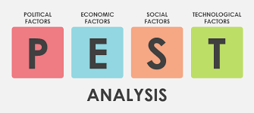
PEST Analysis
PEST analysis is a strategic management tool used to analyze and evaluate the external macro-environmental factors that can affect an organization. The acronym "PEST" stands for Political, Economic, Social, and Technological factors. PEST analysis helps organizations identify and understand the key external influences that could impact their operations, strategies, and decision-making.
By conducting a thorough PEST analysis, organizations gain insights into the external factors that may influence their strategies, planning, and decision-making processes. This information enables businesses to anticipate and adapt to changes in the external environment, allowing for a more informed and proactive approach to strategy development and implementation.
Image Source: Visual Paradigm

Slide 24
PEST Analysis
Political Factors:
These factors refer to the influence of government policies, regulations, stability, and political trends that can affect an organization.
Examples include government stability, taxation policies, trade tariffs, labour laws, government structure, political stability, and level of bureaucracy.
Economic Factors:
Economic factors encompass economic conditions, indicators, and trends that influence an organization's operations, demand for products/services, costs, and profitability.
Examples include economic growth, inflation, exchange rates, interest rates, consumer spending, market demand, and global economic conditions.
Social Factors:
Social factors encompass societal and cultural aspects that impact consumer behaviors, preferences, attitudes, demographics, and lifestyle choices.
Examples include population demographics, cultural attitudes, social trends, consumer attitudes towards products/services, health consciousness, and education levels.
Technological Factors:
Technological factors involve the impact of technological advancements and innovation on an organization's operations, products/services, and competitive advantage.
Examples include automation, research and development (R&D), emerging technologies, disruptive technologies, intellectual property, and access to technology.

Slide 25
Learning Objectives Completed
What is a Strategic Framework
Strategic Framework vs Model
S.W.O.T
Issue Based Strategic Planning
Balanced Scorecard
Objective and Key Results (OKRs)
Gap Planning
PEST Analysis
Image Source: Businessday NG

